Slide 1
MPI (continue)
An example for designing explicit message passing programs
  Emphasize on the difference between shared memory code and distributed memory code.

Slide 2
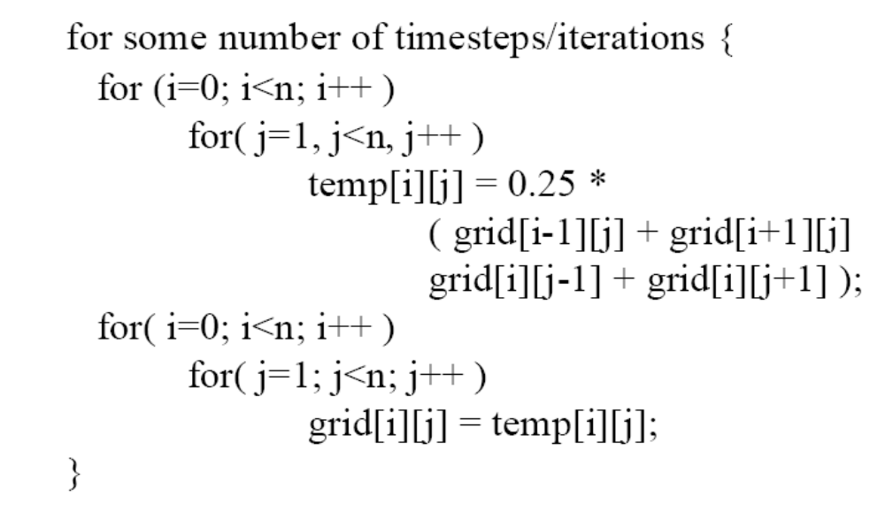
A design example SOR

Slide 3
Parallelizing SOR
How to write a shared memory parallel program?
  Decide how to decompose the computation into parallel parts.
  Create (and destroy) processes to support that decomposition.
  Add synchronization to make sure dependences are covered.

Slide 4
SOR shared memory program
grid
temp
p0
p0
p1
p1
p2
p2
p3
p3
p0
p1
p2
p3
Does parallelizing SOR with MPI work the same way?

Slide 5
MPI program complication: memory is distributed
grid
grid
p0
p1
p2
p1
temp
temp
p2
p1
p2
p3
Grid logical
view
p1
p2
Physical data structure: each process does not have local access to boundary data items!!

Slide 6
Exact same code does not work: need additional boundary elements
grid
grid
p1
p2
temp
temp
p1
p2
p1
p2

Slide 7
Boundary elements result in communications
grid
grid
p1
p2

Slide 8
Communicating boundary elements
Processes 0, 1, 2 send lower row to Processes 1,2 3.
Processes 1, 2, 3 receiver upper row from processes 0, 1, 2
Process 1, 2, 3 send the upper row to processes 0, 1, 2
Processes 0, 1, 2 receive the lower row from processes 1, 2,3
p0
p1
p2
p3

Slide 9
MPI code for Communicating boundary elements
if (rank < size - 1)
MPI_Send( xlocal[maxn/size], maxn, MPI_DOUBLE, rank + 1, 0,
MPI_COMM_WORLD );
if (rank > 0)
MPI_Recv( xlocal[0], maxn, MPI_DOUBLE, rank - 1, 0,
MPI_COMM_WORLD, &status );
/* Send down unless I'm at the bottom */
if (rank > 0)
MPI_Send( xlocal[1], maxn, MPI_DOUBLE, rank - 1, 1,
MPI_COMM_WORLD );
if (rank < size - 1)
MPI_Recv( xlocal[maxn/size+1], maxn, MPI_DOUBLE, rank + 1, 1,
MPI_COMM_WORLD, &status );

Slide 10
Now that we have boundaries
Can we use the same code as in shared memory?
    for( i=from; i<to; i++ )
    for( j=0; j<n; j++ )
    temp[i][j] = 0.25*( grid[i-1][j] + grid[i+1][j]
    + grid[i][j-1] + grid[i][j+1]);
from = myid *25, to = myid*25+25
  Only if we declare a giant array (for the whole mesh on each process).
    If not, we will need to translate the indices.

Slide 11
Index translation
    for( i=0; i<n/p; i++)
    for( j=0; j<n; j++ )
    temp[i][j] = 0.25*( grid[i-1][j] + grid[i+1][j]
    + grid[i][j-1] + grid[i][j+1]);
All variables are local to each process, need the logical mapping!

Slide 12
Task for a message passing programmer
Divide up program in parallel parts.
Create and destroy processes to do above.
Partition and distribute the data.
Communicate data at the right time.
Perform index translation.
Still need to do synchronization?
  Sometimes, but many times goes hand in hand with data communication.

